Slide 1


MULTI MEDIA RECOMMENATION SYSTEM
MOVIE
RECOMENDATION
Title: 🎬 Movie Recommendation System using Machine Learning
Name: Jahir Hussain

Slide 2

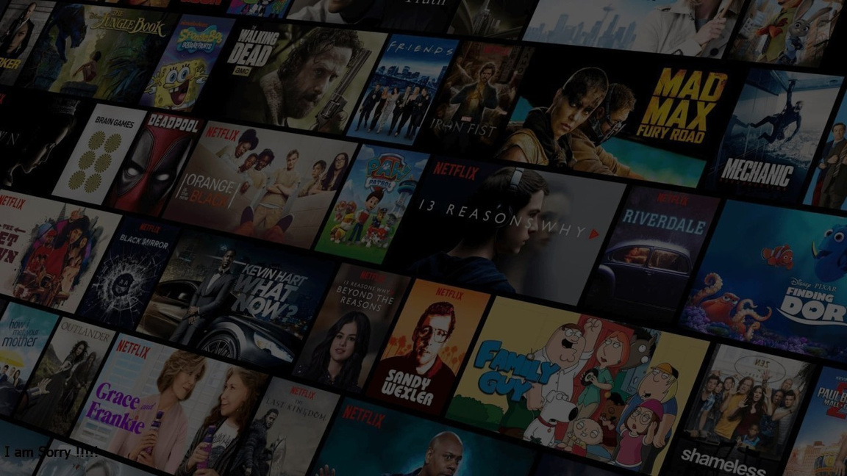
INTRODUCTION
Movies are one of the most consumed forms of digital entertainment.
With thousands of movies available online, users face difficulty in selecting what to watch.
Recommendation systems help users by suggesting relevant movies based on their preferences.
This project implements a content-based movie recommendation system using Machine Learning techniques (TF-IDF & Similarity).

Slide 3
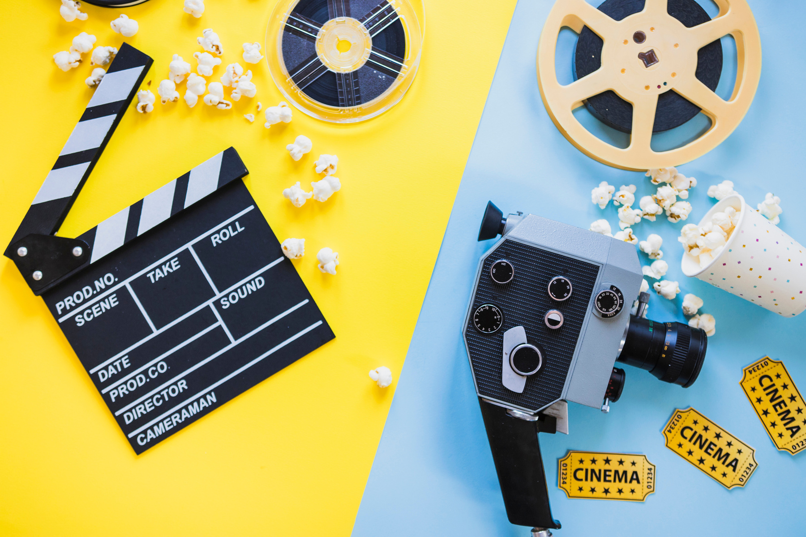
Objectives
To design and develop a content-based recommendation system for movies.
To use machine learning algorithms for similarity-based recommendations.
To build a web application (Flask + HTML/CSS/JS) for user interaction.
To provide recommendations based on Movie Title and Genre.
To create a system that can be extended with more features like Cast, Ratings, Storyline.

Slide 4
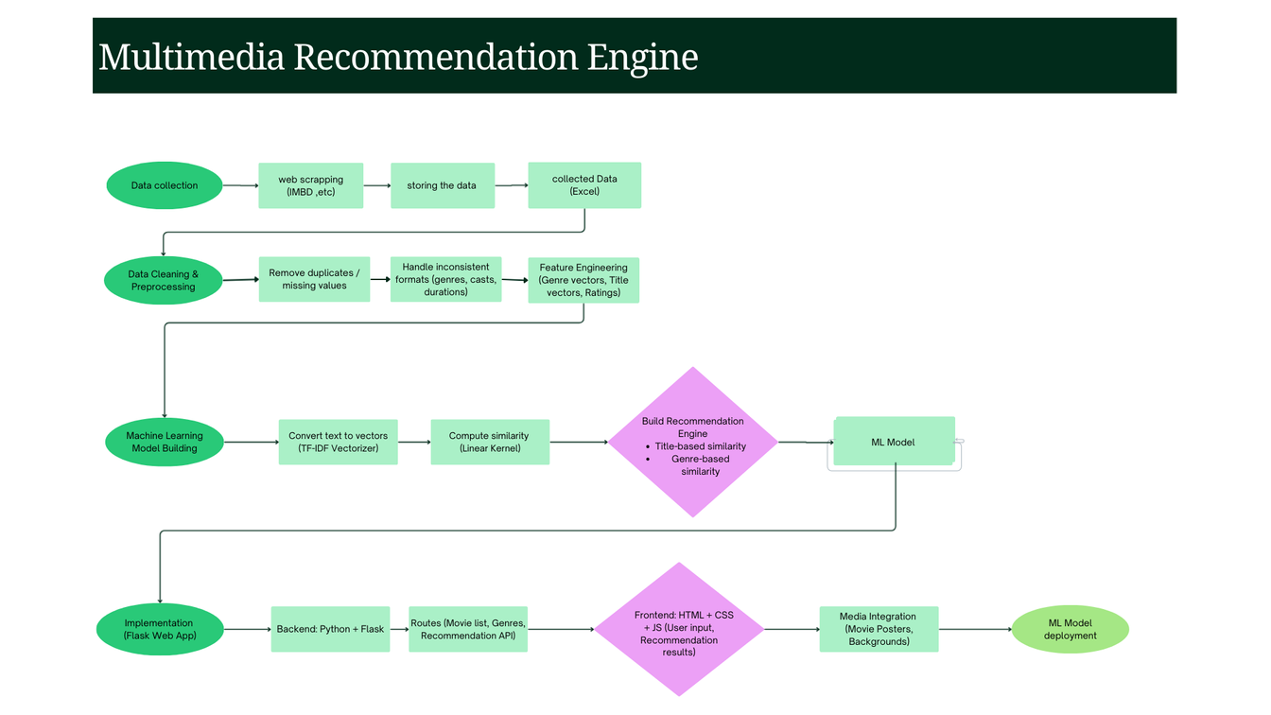
ffffff
SYSTEM ARCHITECTURE / FLOWCHART
Flow:
Data Collection (Web scraping / Movie dataset)
Data Cleaning & Preprocessing (remove duplicates, handle missing values)
Feature Extraction (TF-IDF for Genre, Title)
Model Building (Cosine Similarity with TF-IDF vectors)
Web Application (Flask backend + HTML/CSS frontend)
Final Output: Recommended Movies

Slide 5
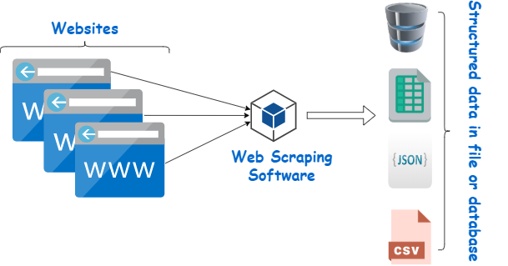
DATA COLLECTION
Dataset prepared using Movie details with images (Excel file).
Includes attributes such as:
Movie Title
Genre
Rating
Duration
Cast
Poster Image (where available)
Some data collected via web scraping and supplemented with manual entries.

Slide 6
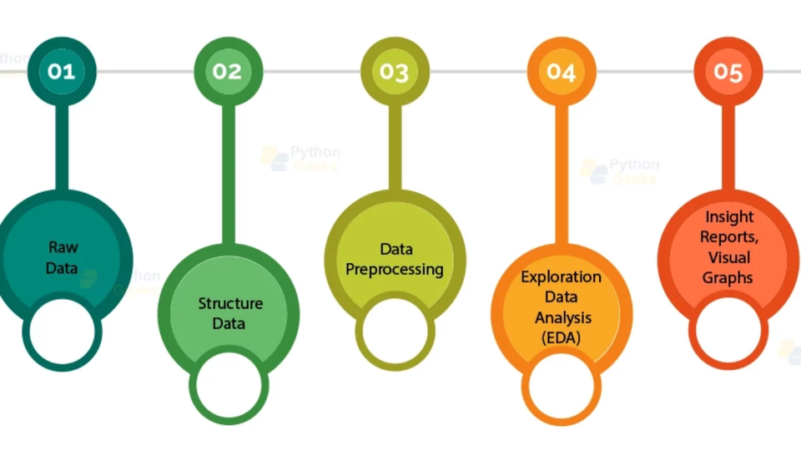
DATA PREPROCESSING
Steps performed:
Fill missing values with defaults.
Clean inconsistent genres (e.g., “Drama,Action” → “Drama, Action”).
Convert all text to lowercase for uniformity.
Extract features using TF-IDF Vectorization.
Two separate vector spaces built:
Genre Vector Space
Movie Title Vector Space

Slide 7
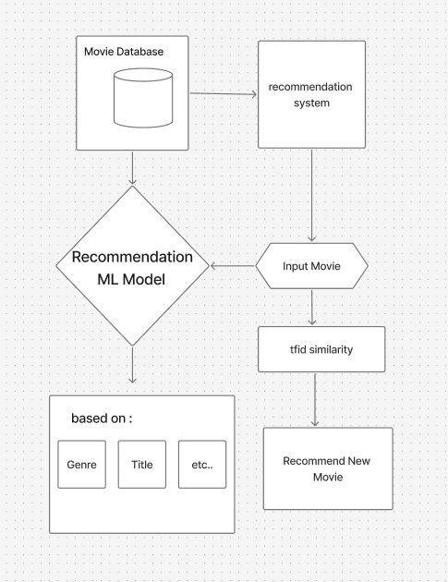
MACHINE LEARNING MODEL
Model Approach: Content-Based Filtering
Technique Used:
TF-IDF Vectorization – Converts text data (titles, genres) into numerical feature vectors.
Cosine Similarity – Measures similarity between two vectors.
Modes of Recommendation:
Based on Movie Title similarity
Based on Genre similarity

Slide 8
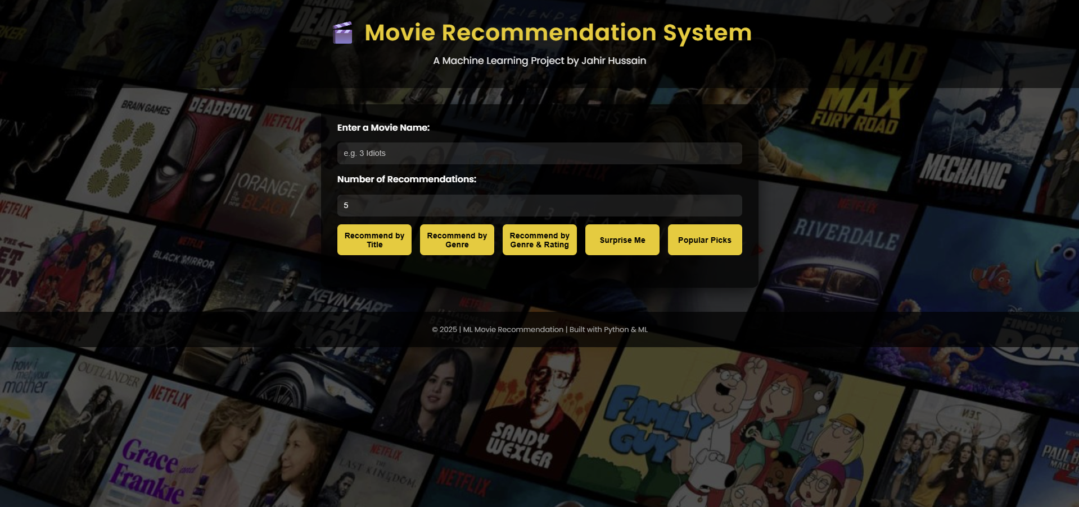
IMPLEMENTATION
Backend: Flask (Python)
Frontend: HTML, CSS, JavaScript
Dataset: Excel file with movie details + images
API Endpoints:
/movies – Provides movie list for autocomplete
/genres – Provides genre list
/recommend – Provides recommendations
User Interface:
Input: Movie name & number of recommendations
Buttons: Recommend by Title / Genre
Output: Recommended movies with Title, Rating, Duration, Genre, Cast, Poster

Slide 9
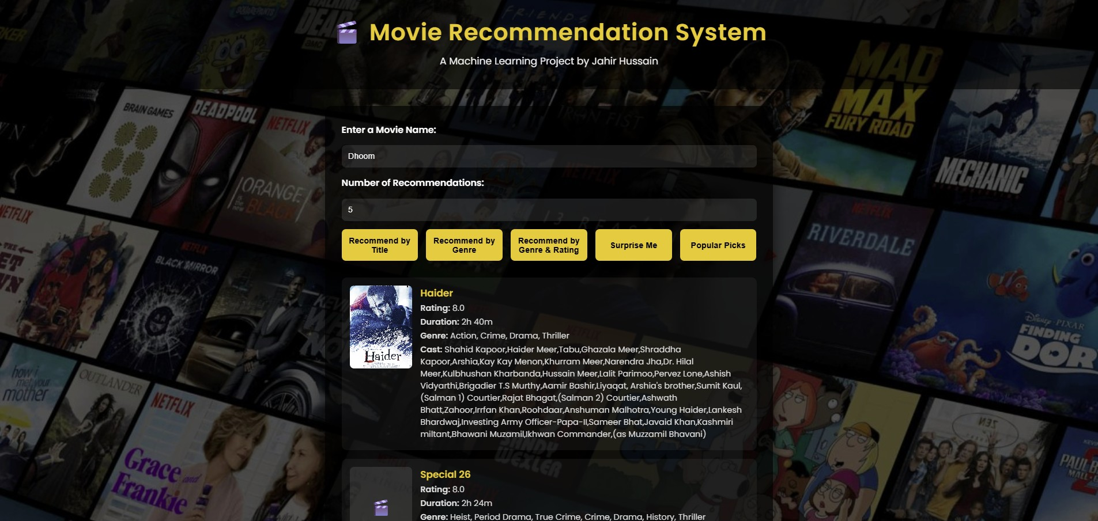
RESULTS
Successfully recommends movies similar by Title or Genre.
Provides movie details with rating, cast, duration.
Integrated with movie posters (where available).
Example:
Input: “3 Idiots”
Recommendations:
PK,
Taare Zameen Par,
Munna Bhai M.B.B.S., etc.

Slide 10

THANK YOU

